Slide 1
Video game sales analysis

Slide 2
introduction
Video games industry is worth billions of dollars.
Looking for the best-selling games of all time, it's always a mix.
Valuable insights can be drawn through analysis.
Helps in development of video games.

Slide 3
Data description
Rank
Name
Platform
Year
Genre
Publisher
NA_Sales
EU_Sales
JP_Sales
Other_Sales
Global_Sales

Slide 4
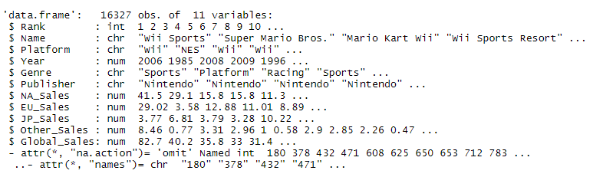
DATA cleaning
Remove NULL values
Data type conversion

Slide 5
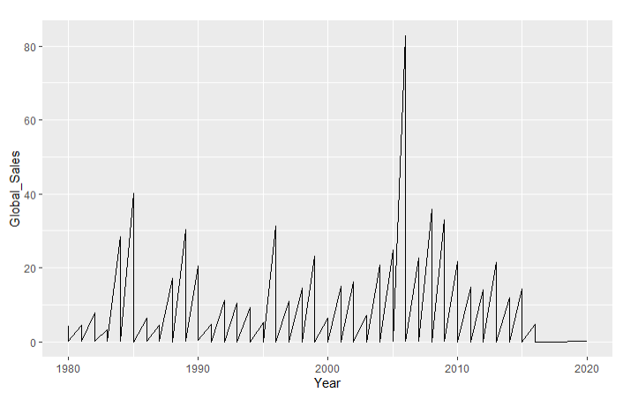
Global sales over the years

Slide 6
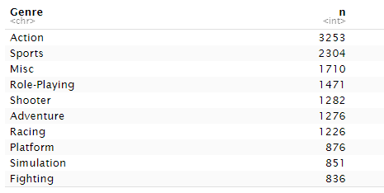
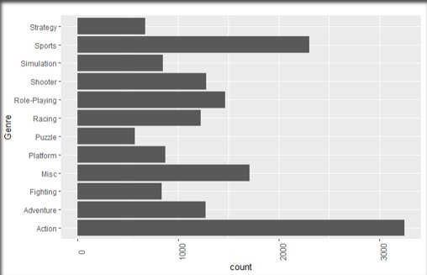
Analysis by genre

Slide 7
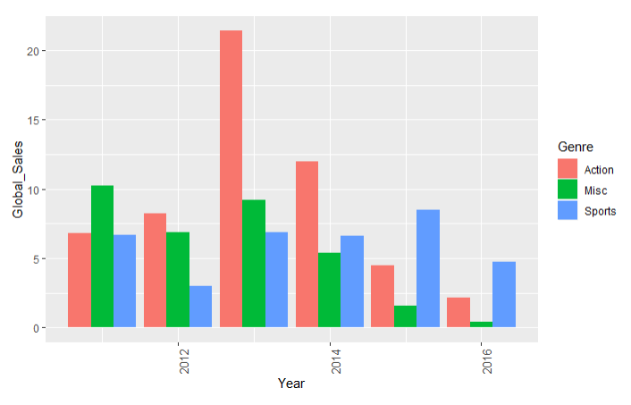

Slide 8
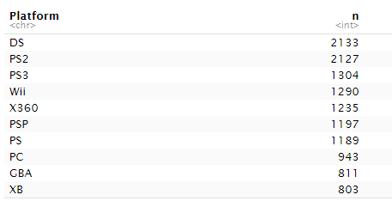
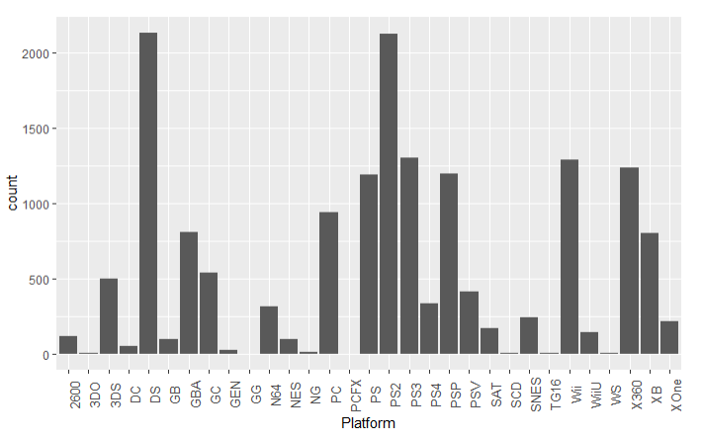
Analysis by platform

Slide 9
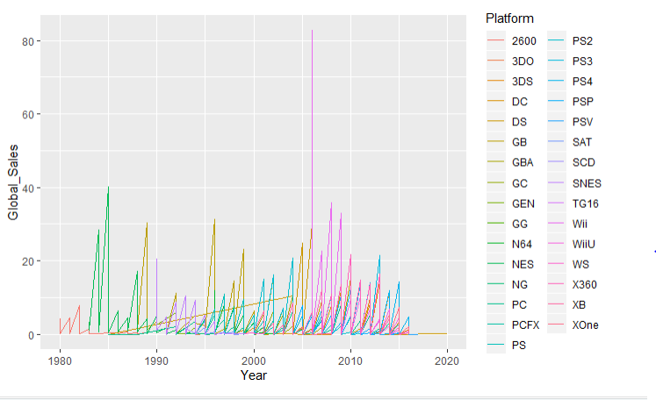
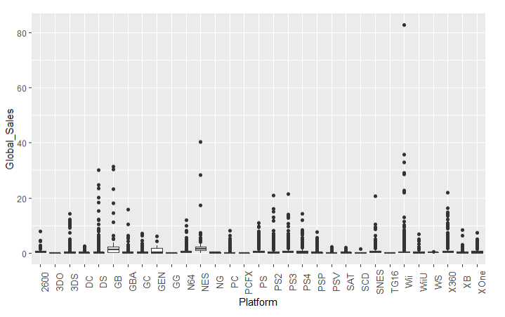
Continued...

Slide 10
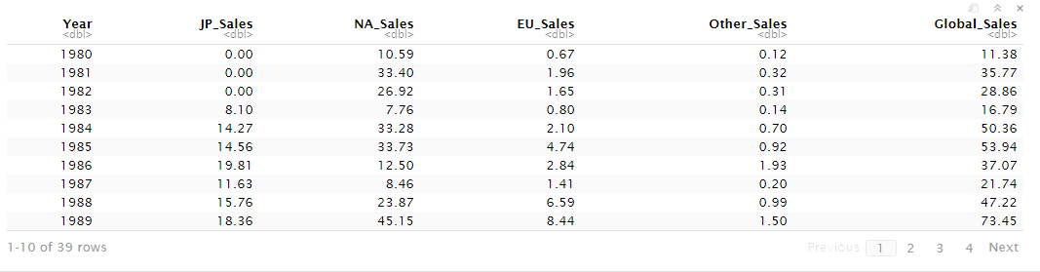
Analysis by region

Slide 11
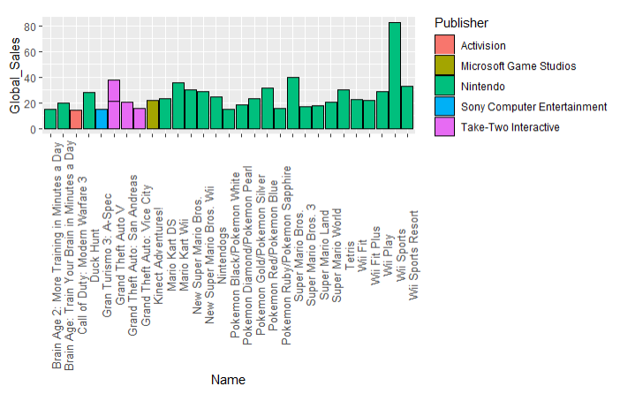
Analysis by publisher

Slide 12
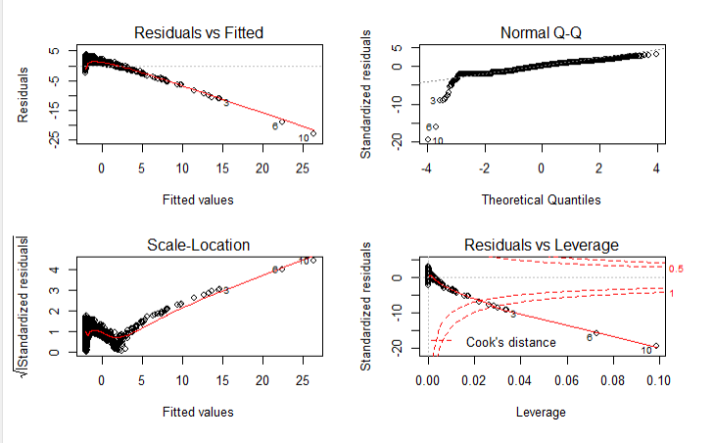
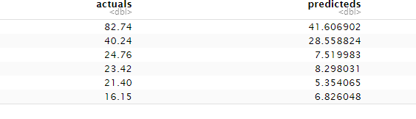
Prediction of global sales

Slide 13
conclusion
Sports Genre gains popularity day by day whereas action genre is vice versa.
North America contributes more towards global sales.
Sony manages to be in top and Nintendo gets more attention

